Slide 1

A Presentation On My Self
AMMAR MALIK - 24756

Slide 2

My Birthday
I was Born on a Monday morning on the 26th of August 2002.

Slide 3
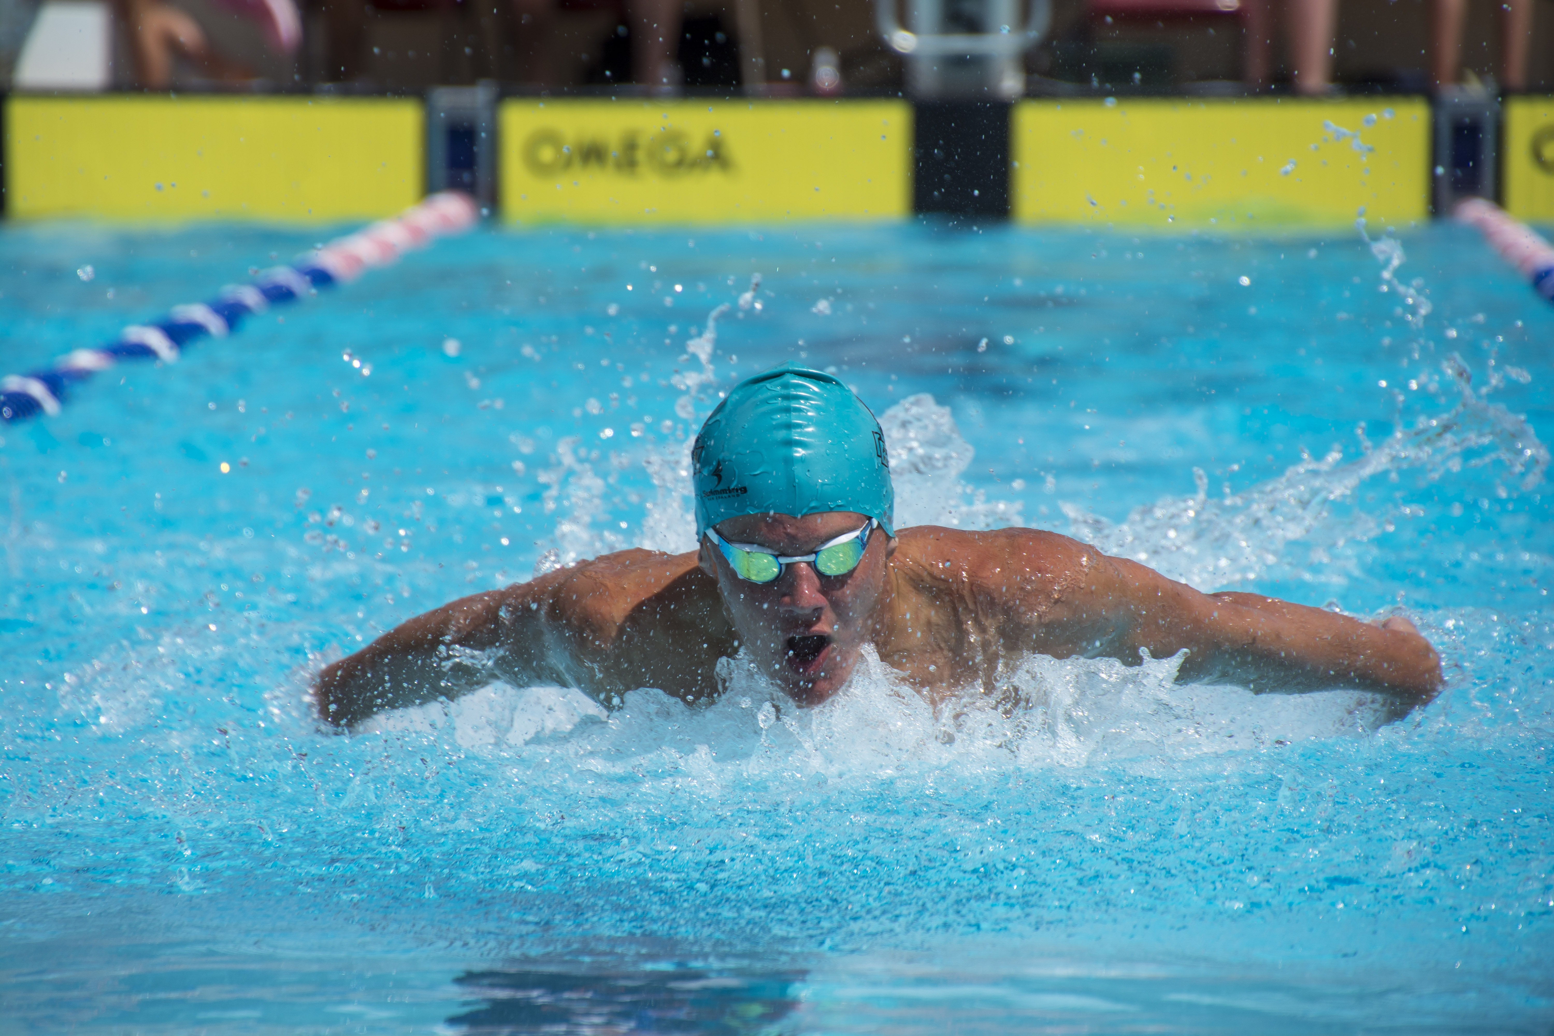
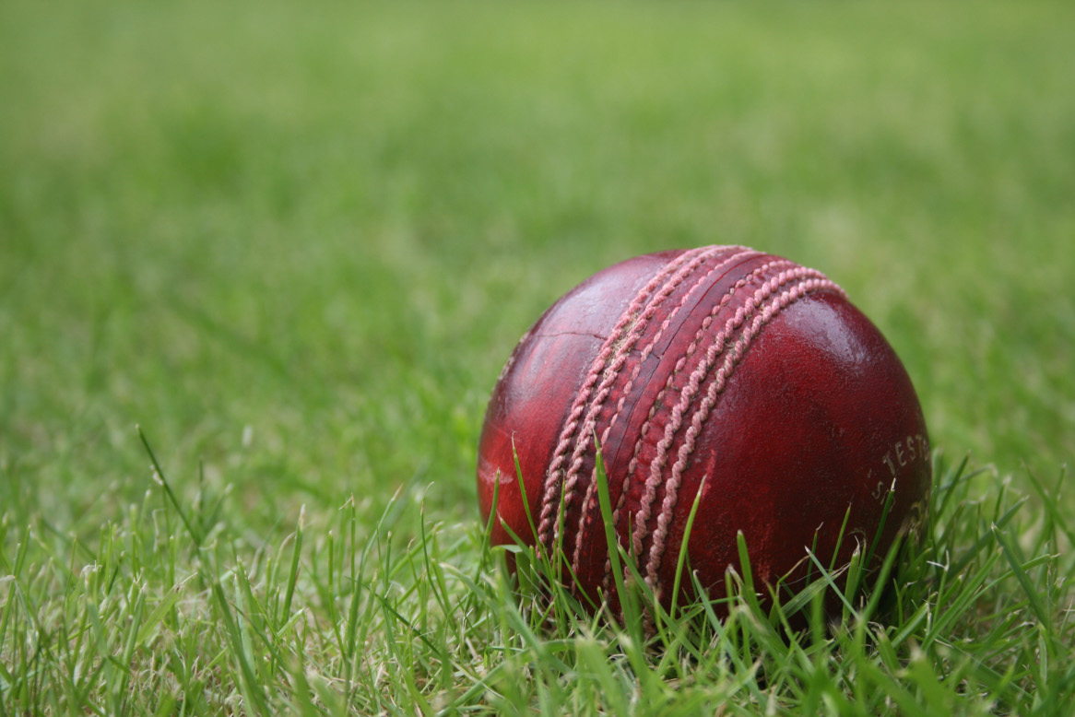
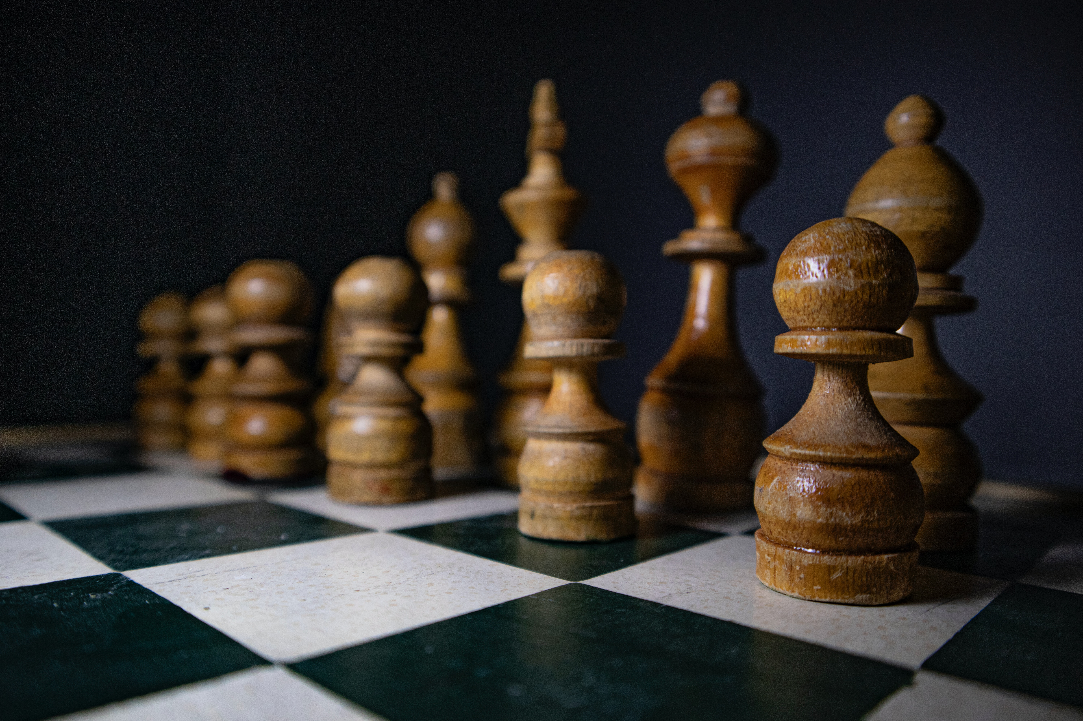
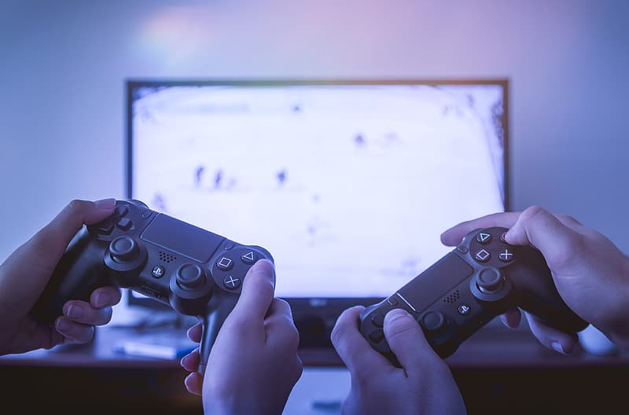
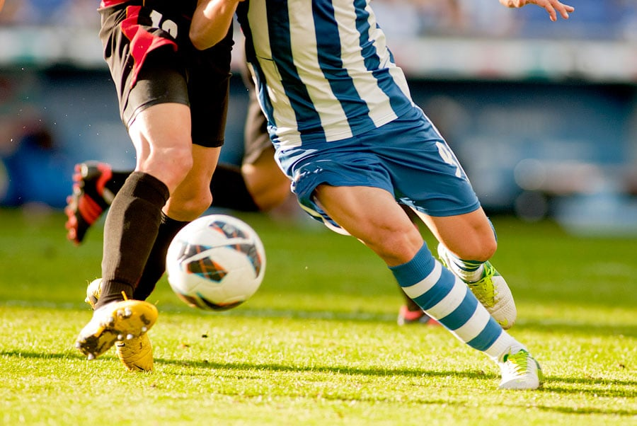
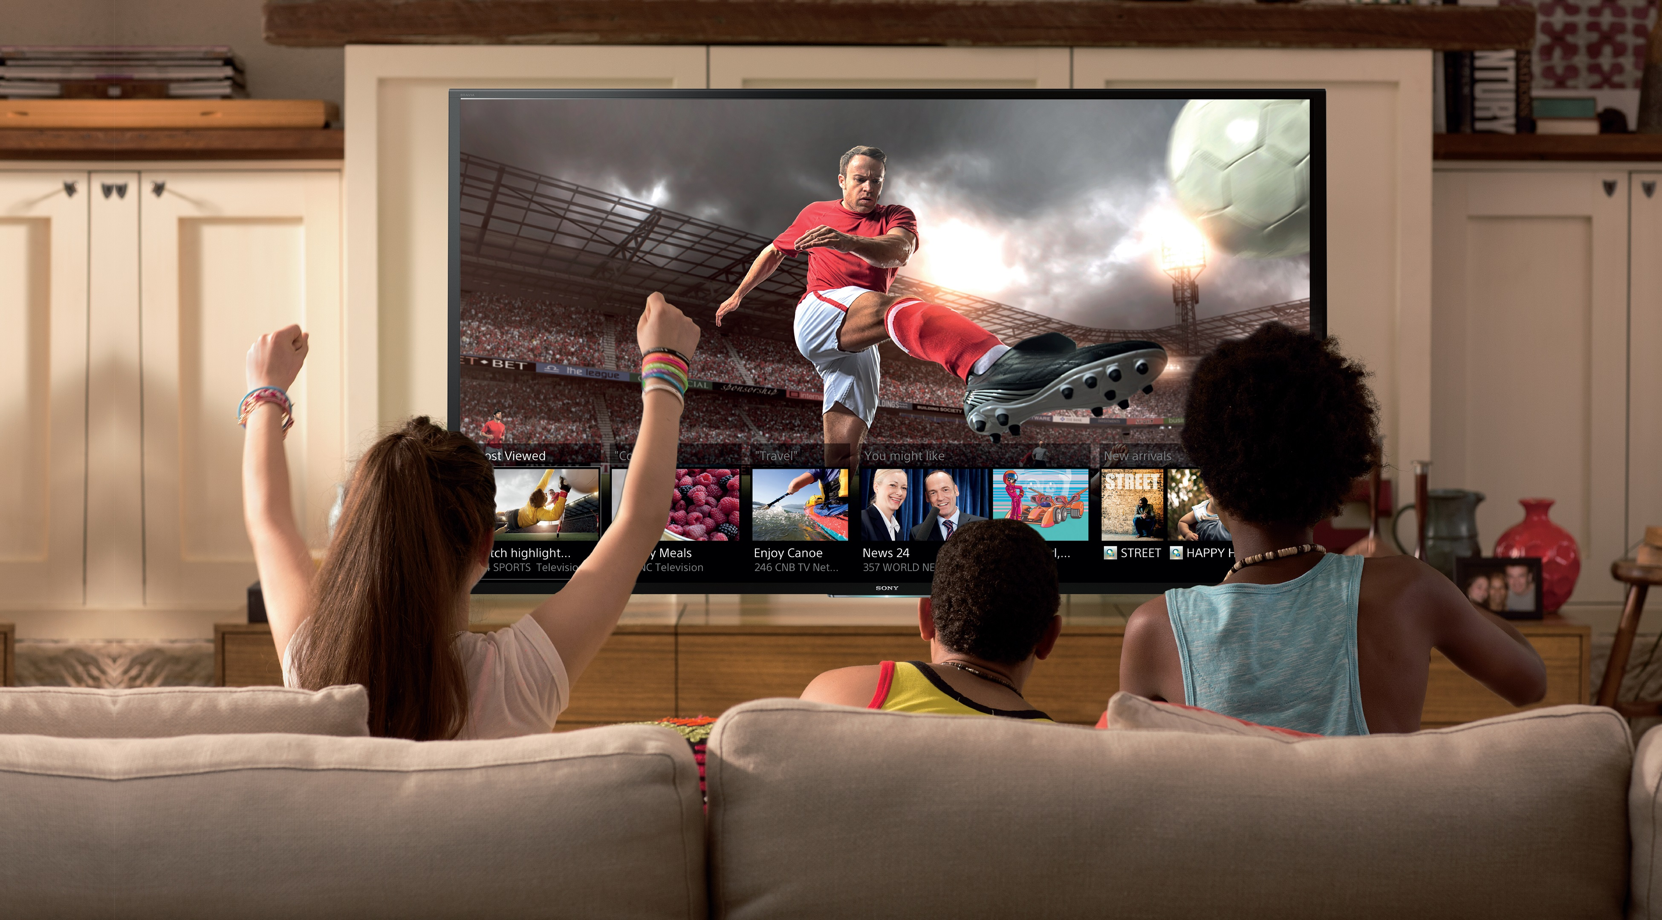
Hobbies:
I have had multiple hobbies throughout my life that I still practice to this date. Over the years, some of my major hobbies were doing and playing:
Swimming
Chess
Football
Cricket
Video-Games
Watching Television

Slide 4
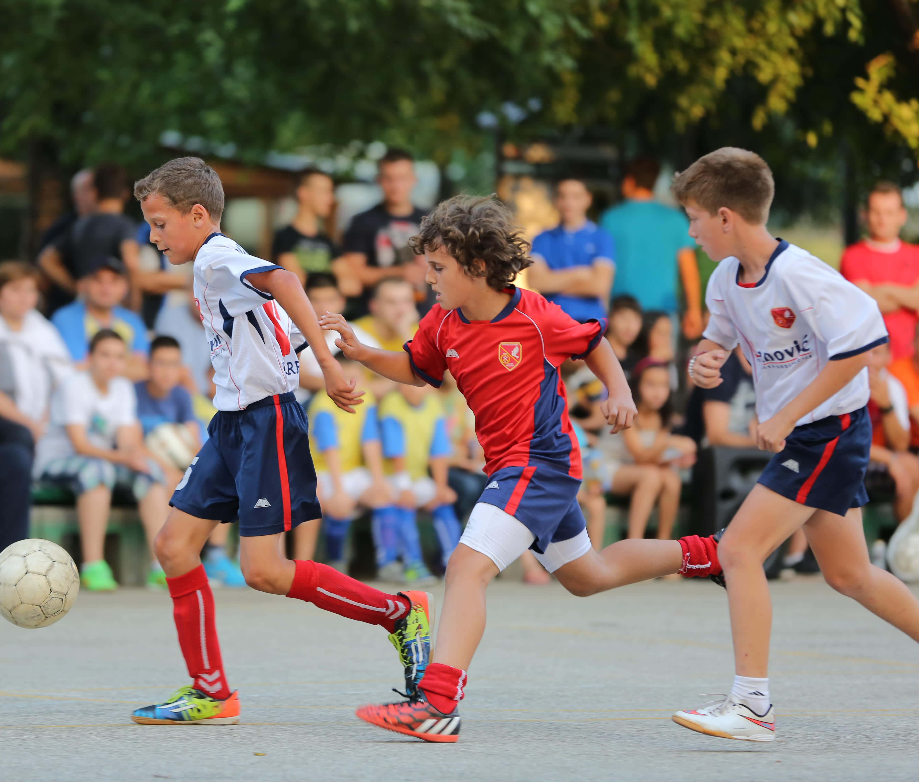
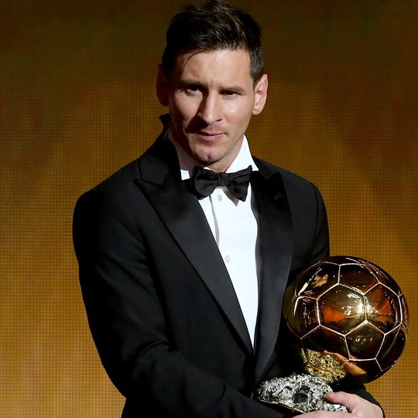
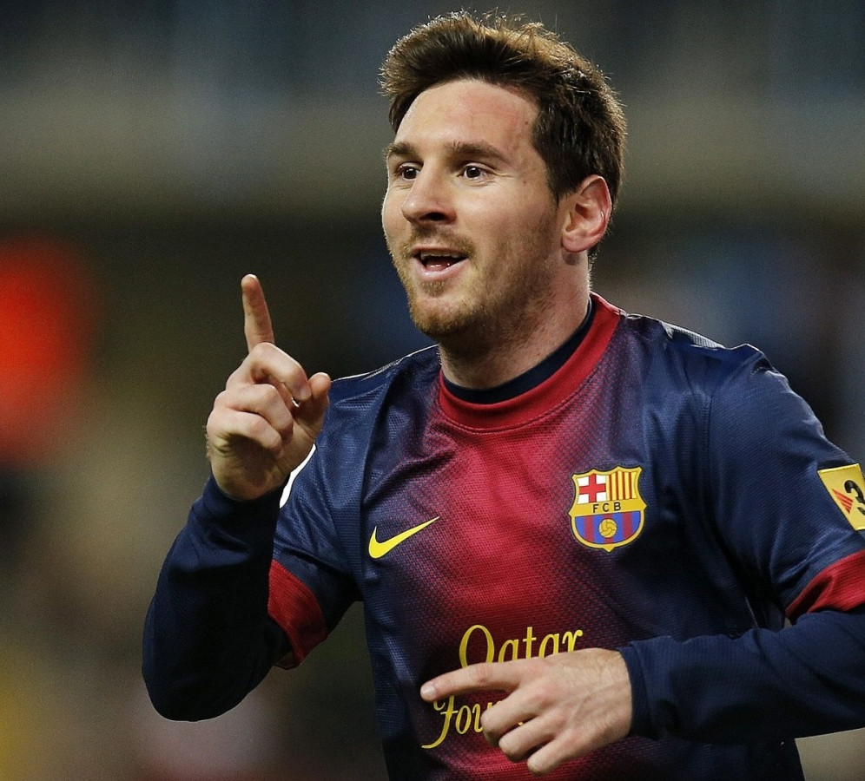
As the years passed, my hobby changed from playing cricket, to watching and playing endless football. My passion for football started when I watched the amazing Lionel Messi play in 2012. Since then he has managed to grab innumerable trophies both for himself, and his club FC Barcelona. Messi has always managed to exceed my expectations and he has also managed to grab his 7th Balon D’or last week at the age of 34.

Slide 5




Education:
Grade 1 – Grade 6 from the City School PAF Chapter, Karachi.
Grade 7 – Grade 8 from the Scholars International Academy, Dubai.
O’ Levels from The City School PAF Chapter, Karachi.
A’ Levels from Nixor.
BBA from Institute of Business Administration, Karachi.

Slide 6

Achievements & Extracurriculars:
Headboy at Scholars International Academy
Won numerous trophies and medals in Soccer in interhouse and interschool torunaments.
House Captain at TCS PAF CHAPTER
President of the Science Society O’Levels at TCS PAF Chapter
Class Prefect Grade 11
Teacher Assistant of Computer Science at Nixor College
Studied at 100% scholarship in A’Levels

Slide 7
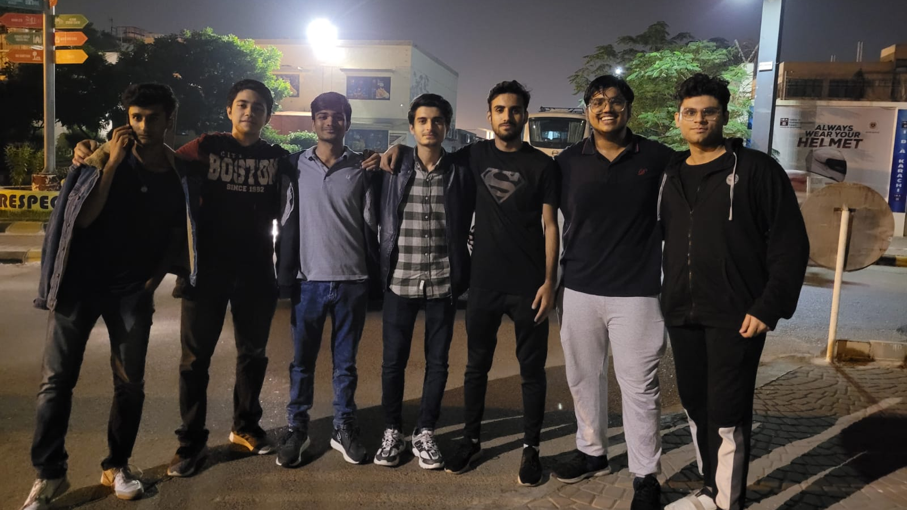
Friends:
The friends that I have made have gone different ways throughout the years, but I have not lost contact with them. When I came to IBA I thought that making friends would be hard as In university mostly every person you meet has different aims and goals. But, who knew that I would make such friends here with whom I would make immeasurbale and wonderful memories which I would cherish later on in life.

Slide 8
Languages:
I can fully speak and understand the following languages which I have learnt throughout the years.
Urdu
English
Punjabi
French
Arabic
Spanish

Slide 9
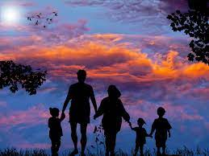
Family:
There are 5 members in my family. I am the eldest one out of all my siblings. I have a sister who is younger than me, then a brother who is the youngest.

Slide 10
I would like to conclude my presentation by the following idea and quote that every person should embrace in their life.
Every persons life is filled with up and downs, as a wise man once said:
“Life is filled with Ups and Downs, without the downs, the Ups would mean nothing.”
There are many setbacks that we face in our life, but we should never be stressed out by them and we should always find one way or another to deal with them, as life is not about the ups or down we experience, it’s the way we deal with them.

Slide 11

Thank You For Watching!

